Slide 1

How to choose

Slide 2
Python tools span taxonomy from Jeffrey Heer (2017)

Slide 3
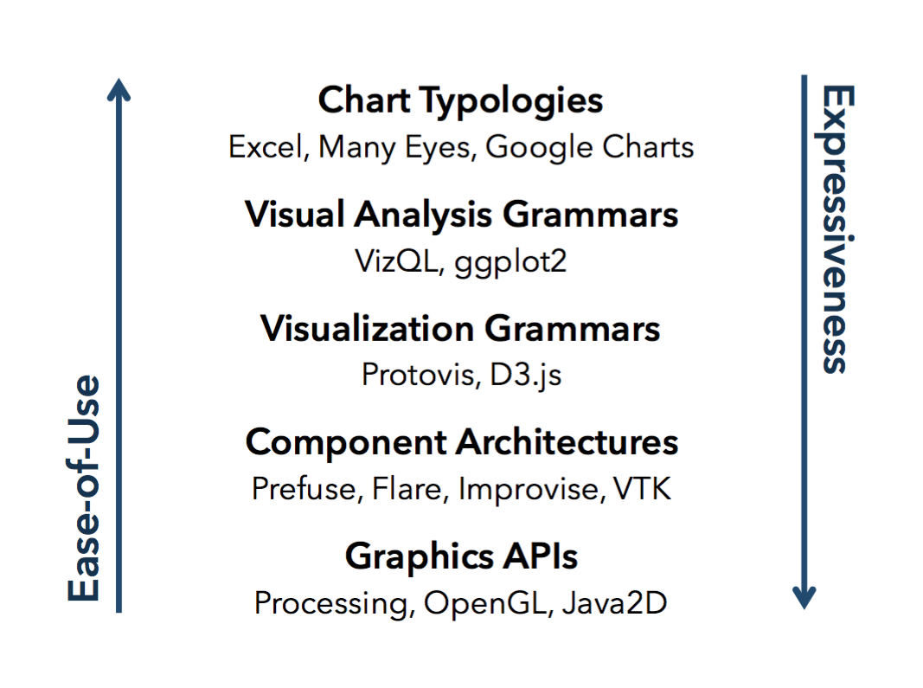

Slide 4
Plotly, Seaborn, Bokeh, MPL PyPlot
MPL API, Ipython Vega
D3+Jupyter
MPL Artists
MPL Backend

Slide 5
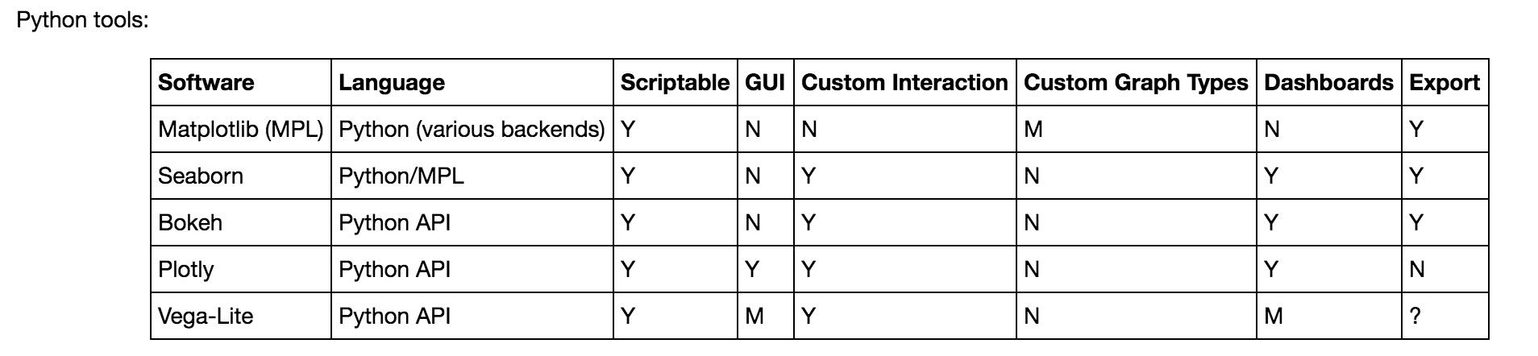

Slide 8


